Slide 1
Animal Tracks
Notes:
Ask students: “What is your favorite animal?” Let several students answer the question. Ask: “Do you know what all of these animals have in common?” Tracks!

Slide 2
Notes:
This morning we discussed some of the symbols in this image. In National Park Service sites, we protect all of these things, including animals and their tracks!
Today we will be learning about animal tracks. Animal tracks can tell you so much about the animals in the area. There are several different things you should consider when tracking, but today, we are going to focus on size and movement!

Slide 3
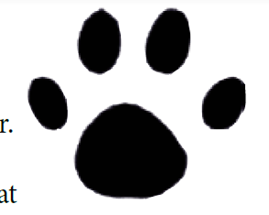
Notes:
There are different parts to a track! Let’s look at this bear track as an example.
Point out the different parts of the track. Point out that most animals will leave claw marks, but felines will not leave any claw marks. Ask students who has a cat, ask a student who has a cat what their claws are like. Click for Lynx track (no claws)
Some animals do not have toes like this print shows. Can you think of any animals that do not have toes like me and you?

Slide 4
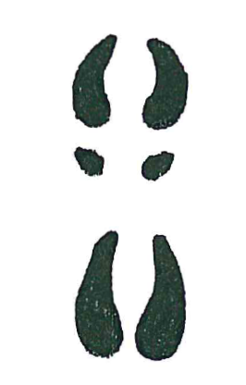
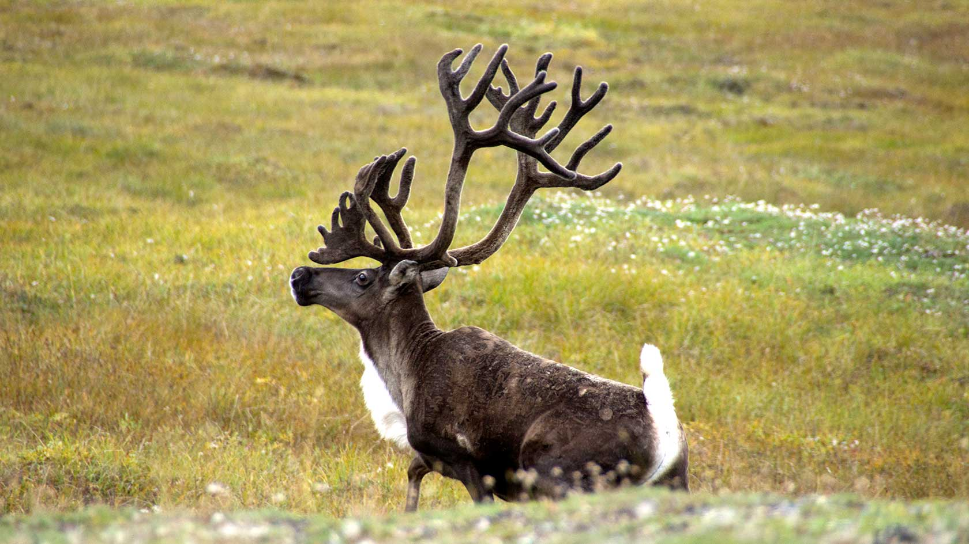
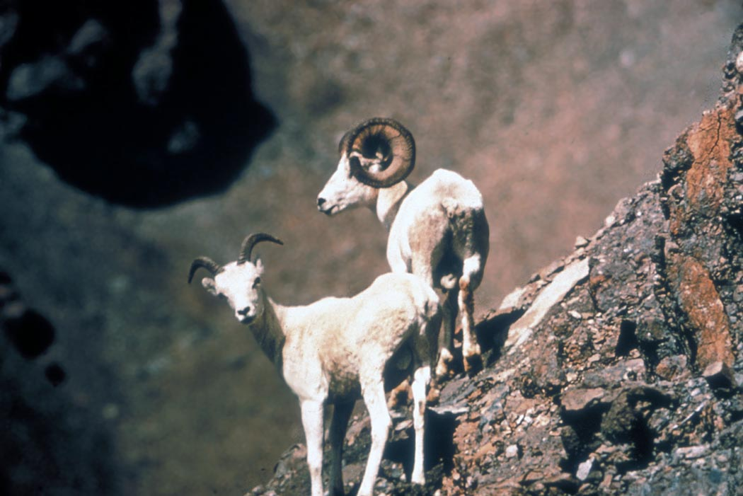
Caribou track
Sheep track
Notes:
Animals like moose, caribou, and sheep are ungulates. Have students repeat “ungulates” Ungulates are hooved animals.
Show sheep hoof.
Ungulate tracks look like this.
Trace a student’s foot with a pencil on paper. Trace your own foot on the same piece of paper.

Slide 5
Size
This track is approximately 1.5 inches tall (length) and 1 inch wide (width).
This track is approximately 4 inches tall (length) and 3 inches wide (width).
Red Fox
Gray Wolf
Notes:
The taller person (typically) has larger feet. Imagine if we switched feet. That would look so silly!
We can estimate the size of an animal by the size of a track it leaves. These two tracks look very similar. Both tracks have four toes, a palm pad, and four claws. However, one track is bigger than the other. Who wants to guess what animals these tracks belong to? (Click for answers)

Slide 6
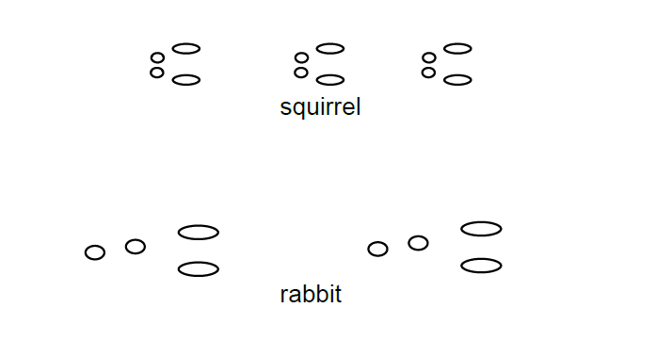
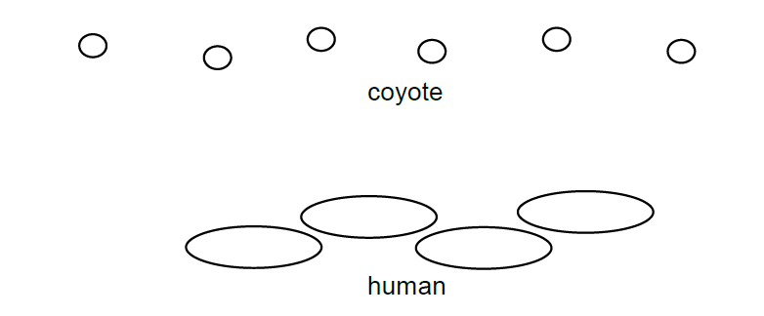
Movement
Walk
Foxes, wolves, and humans
Bound or hop
Squirrels, rabbits, and weasels
Notes:
In addition to size, tracks also show us how animals move. Some animals walk. Have a student demonstrate what walking means. Some examples of animals that walk are foxes, wolves, and humans.
Some animals bound. Have a student demonstrate what it looks like to bound. Some animals that bound or hop are squirrels, rabbits, and weasels. When an animal bounds, it pushes off with both back feet at the same time. The back feet land in front of the front feet.

Slide 7
Activity Time!
Notes:
Ensure every group has a track, chalk, a ruler, writing utensil, and their track reference keychain.

